Slide 1

Chapter 1:
Introduction to Expert Systems
Expert Systems: Principles and Programming, Fourth Edition

Slide 2
Objectives
Learn the meaning of an expert system
Understand the problem domain and knowledge domain
Learn the advantages of an expert system
Understand the stages in the development of an expert system
Examine the general characteristics of an expert system

Slide 3
Objectives
Examine earlier expert systems which have given rise to today’s knowledge-based systems
Explore the applications of expert systems in use today
Examine the structure of a rule-based expert system
Learn the difference between procedural and nonprocedural paradigms
What are the characteristics of artificial neural systems

Slide 4
What is an expert system?
“An expert system is a computer system that emulates, or acts in all respects, with the decision-making capabilities of a human expert.”
Professor Edward Feigenbaum
Stanford University

Slide 5
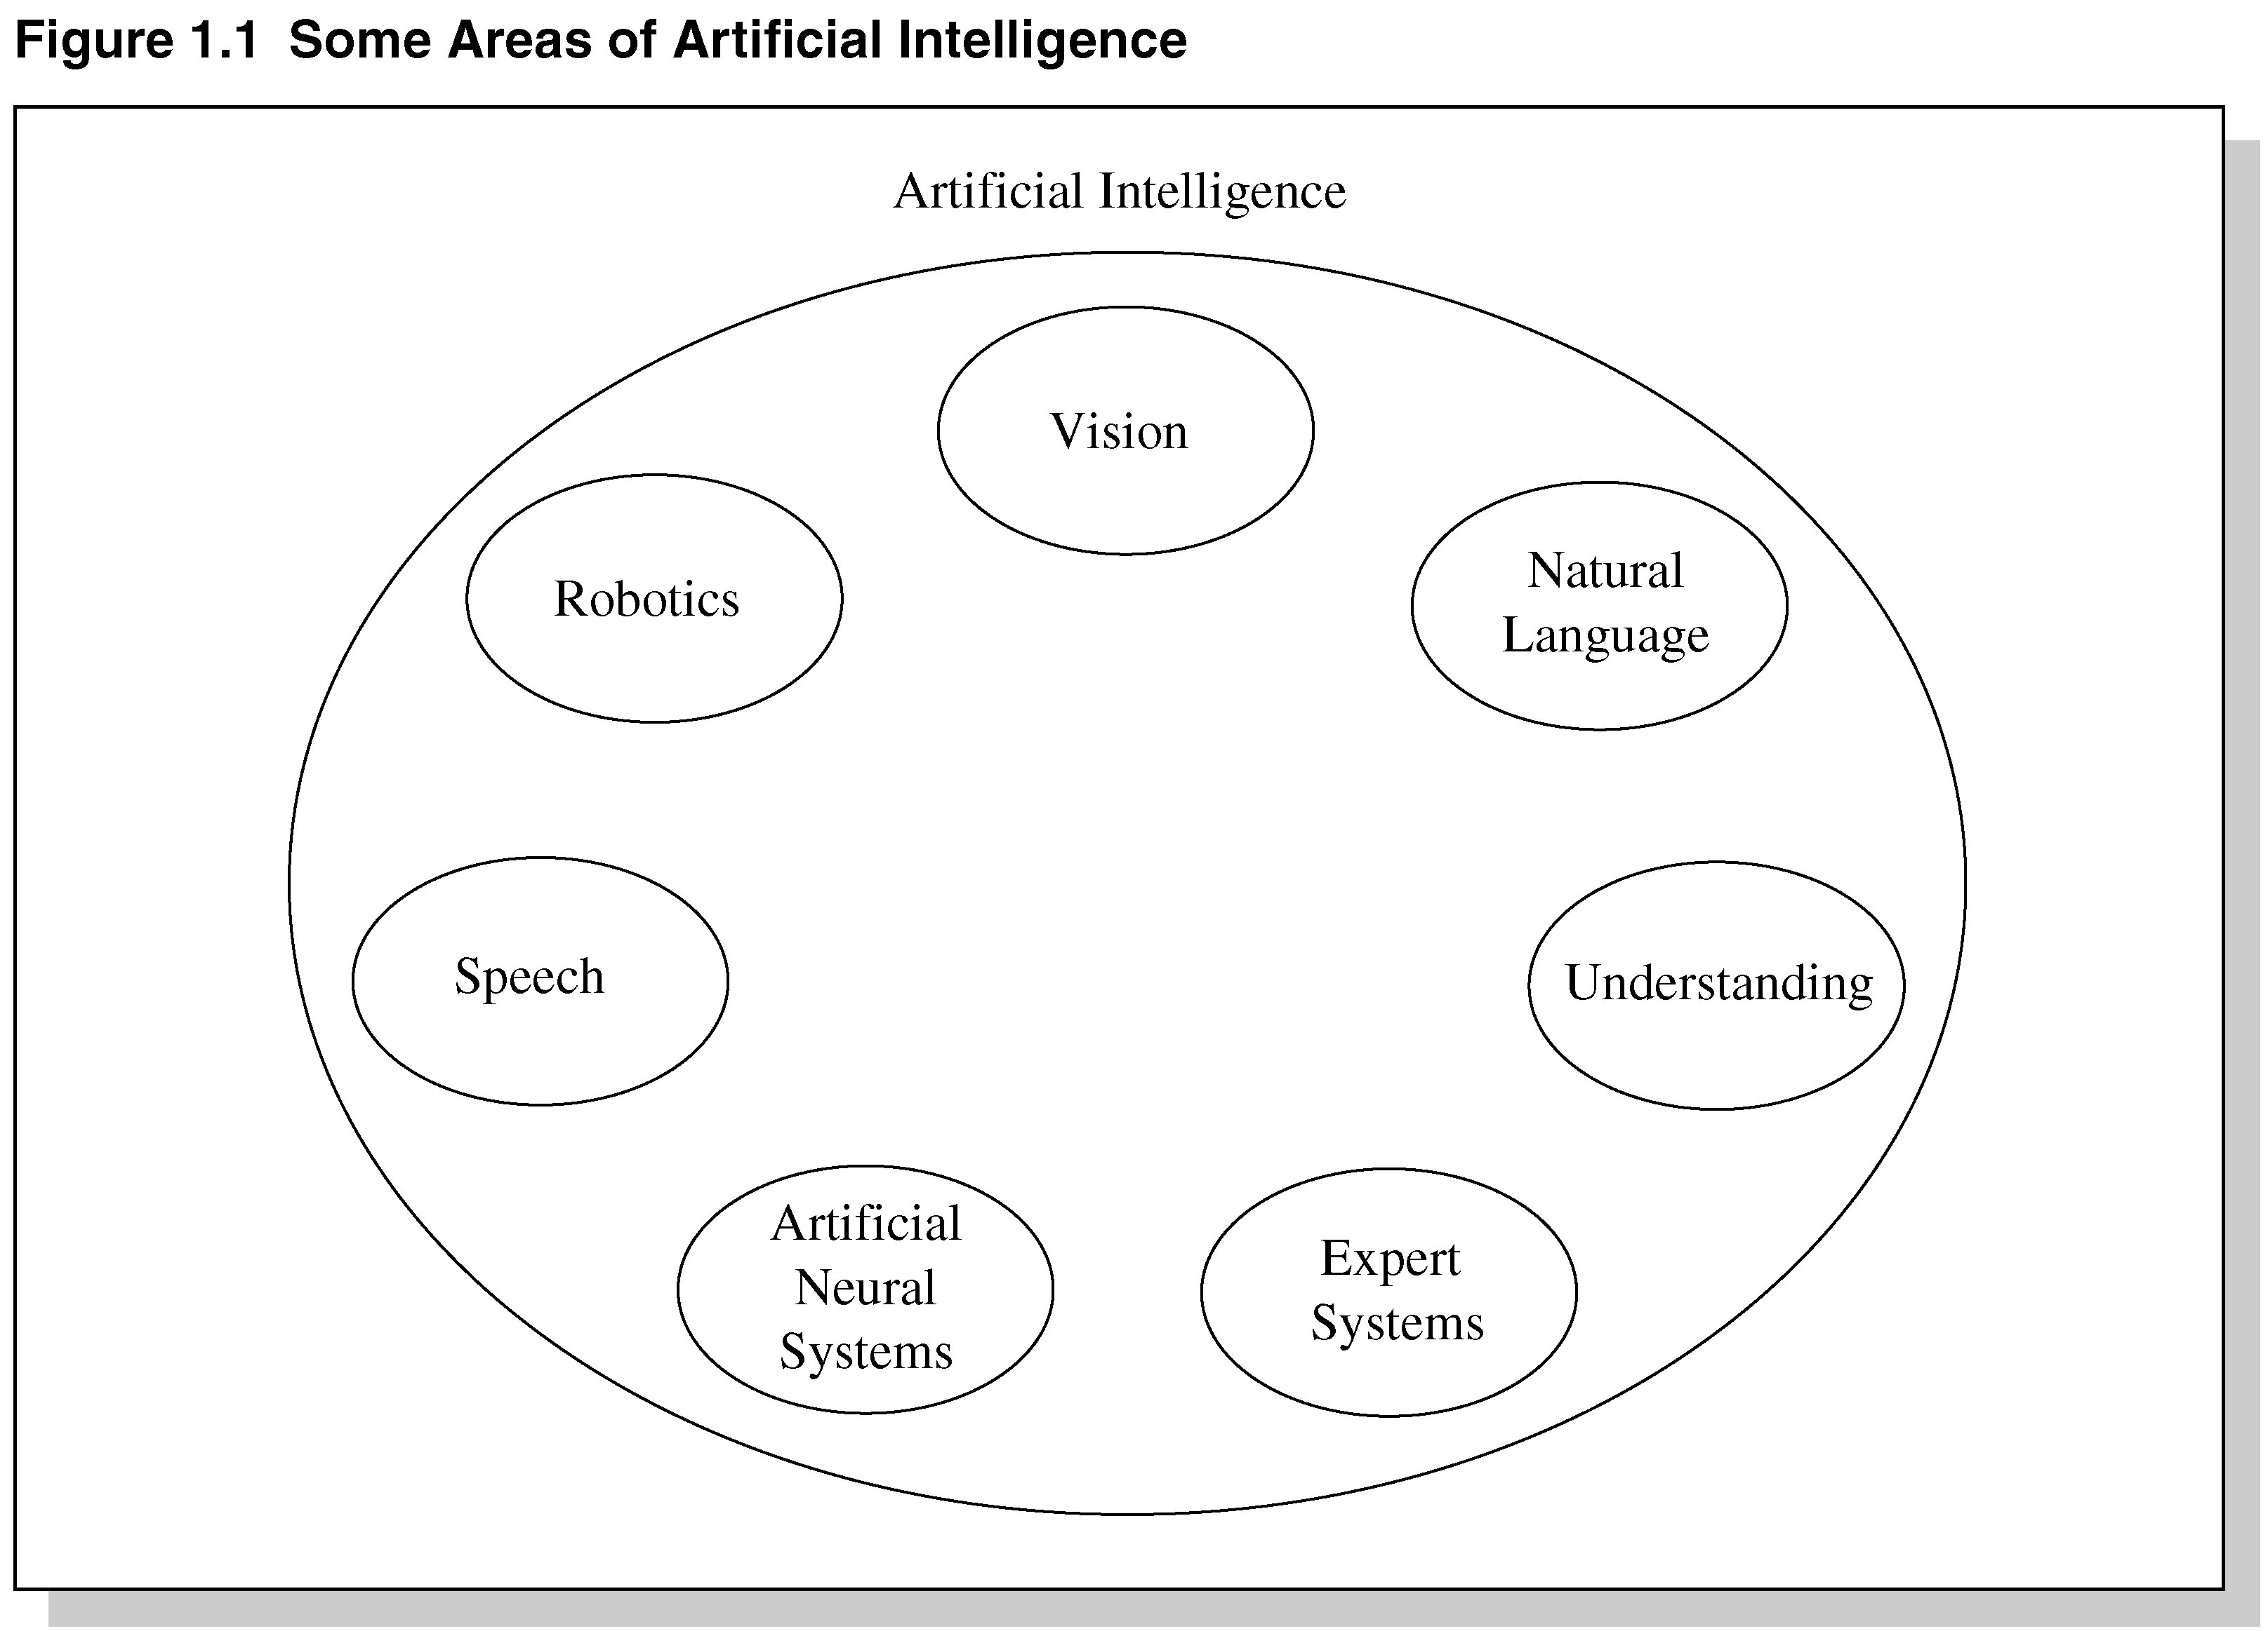
Fig 1.1 Areas of Artificial Intelligence

Slide 6
Expert system technology may include:
Special expert system languages – CLIPS
Programs
Hardware designed to facilitate the implementation of those systems

Slide 7
Expert System Main Components
Knowledge base – obtainable from books, magazines, knowledgeable persons, etc.
Inference engine – draws conclusions from the knowledge base

Slide 8
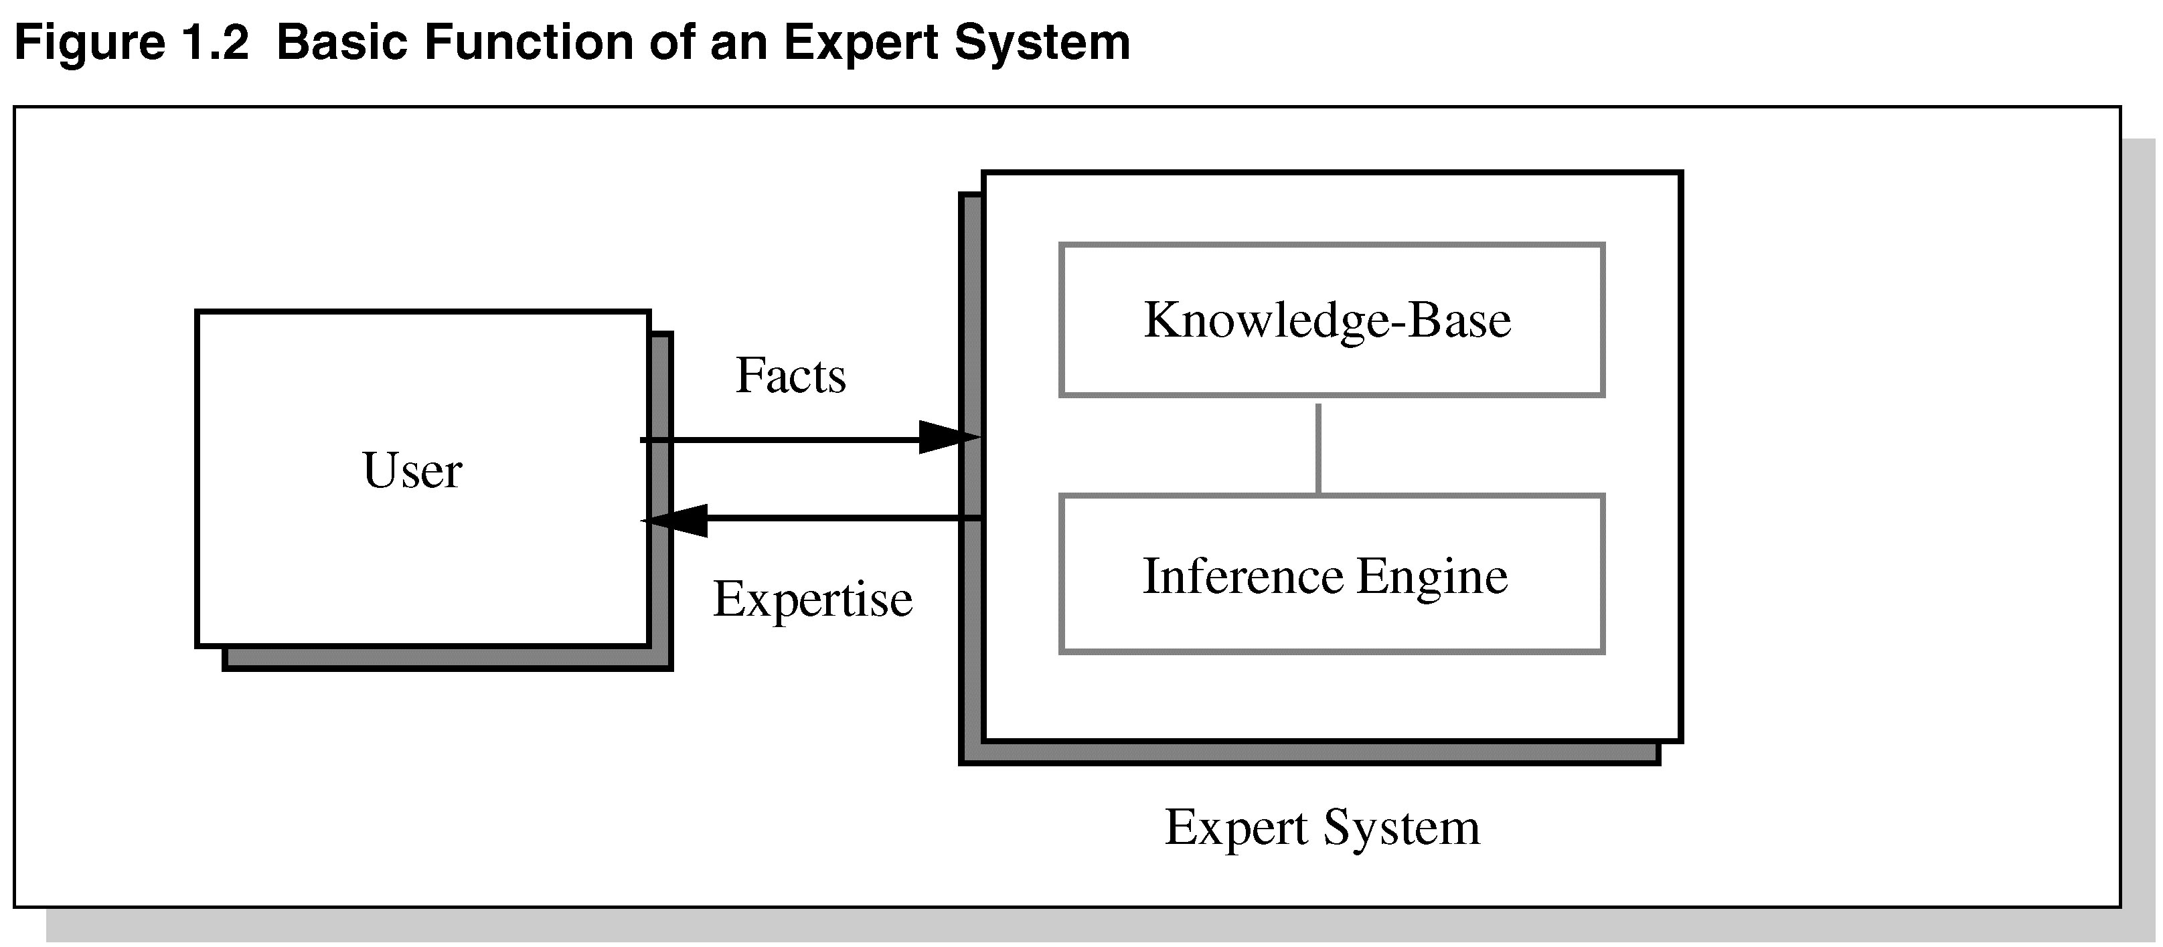
Figure 1.2 Basic Functions of Expert Systems

Slide 9
Problem Domain vs. Knowledge Domain
An expert’s knowledge is specific to one problem domain – medicine, finance, science, engineering, etc.
The expert’s knowledge about solving specific problems is called the knowledge domain.
The problem domain is always a superset of the knowledge domain.

Slide 10
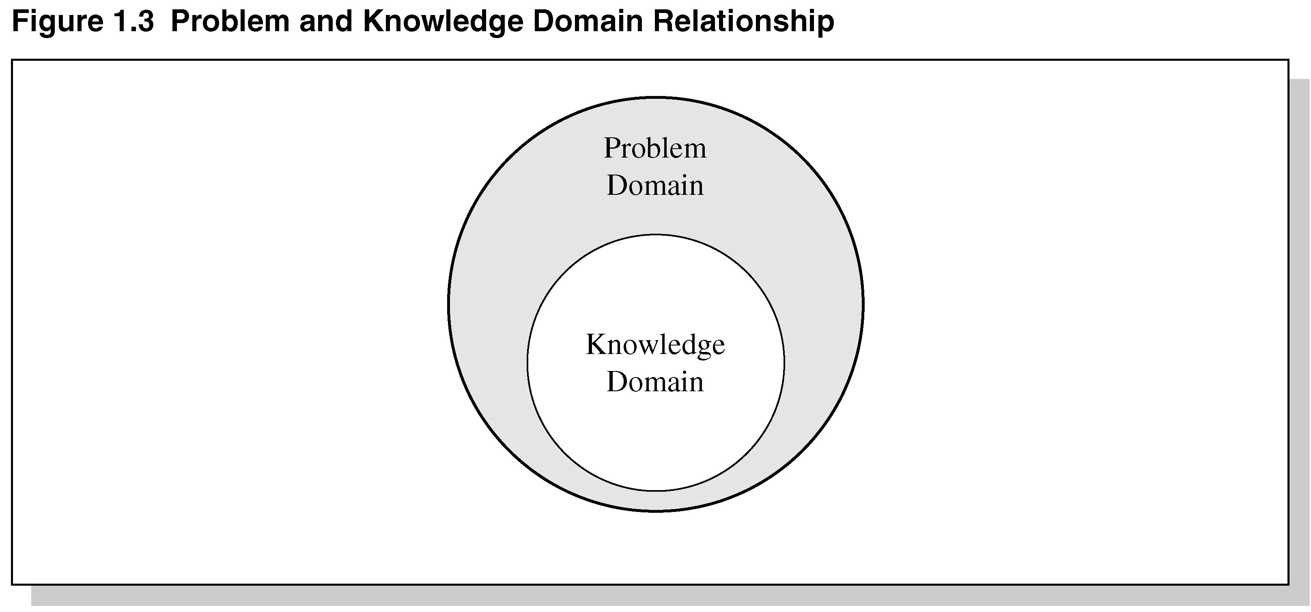
Figure 1.3 Problem and Knowledge Domain Relationship

Slide 11
Advantages of Expert Systems
Increased availability
Reduced cost
Reduced danger
Performance
Multiple expertise
Increased reliability

Slide 12
Advantages Continued
Explanation
Fast response
Steady, unemotional, and complete responses at all times
Intelligent tutor
Intelligent database

Slide 13
Representing the Knowledge
The knowledge of an expert system can be represented in a number of ways, including IF-THEN rules:
IF you are hungry THEN eat

Slide 14
Knowledge Engineering
The process of building an expert system:
The knowledge engineer establishes a dialog with the human expert to elicit knowledge.
The knowledge engineer codes the knowledge explicitly in the knowledge base.
The expert evaluates the expert system and gives a critique to the knowledge engineer.

Slide 15
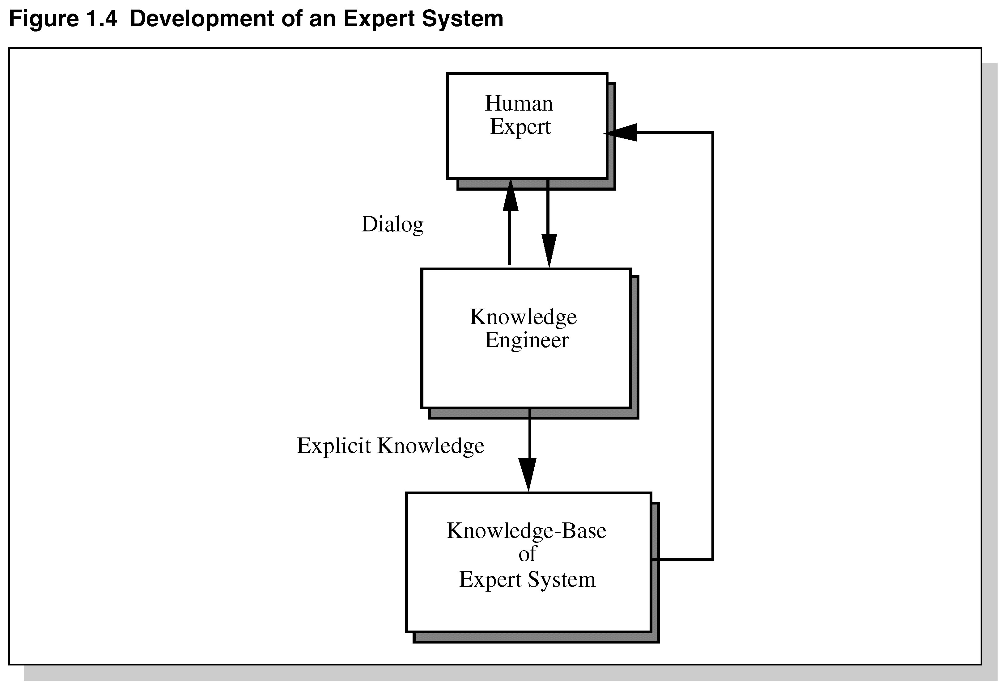
Development of an Expert System

Slide 16
The Role of AI
An algorithm is an ideal solution guaranteed to yield a solution in a finite amount of time.
When an algorithm is not available or is insufficient, we rely on artificial intelligence (AI).
Expert system relies on inference – we accept a “reasonable solution.”

Slide 17
Uncertainty
Both human experts and expert systems must be able to deal with uncertainty.
It is easier to program expert systems with shallow knowledge than with deep knowledge.
Shallow knowledge – based on empirical and heuristic knowledge.
Deep knowledge – based on basic structure, function, and behavior of objects.

Slide 18
Limitations of Expert Systems
Typical expert systems cannot generalize through analogy to reason about new situations in the way people can.
A knowledge acquisition bottleneck results from the time-consuming and labor intensive task of building an expert system.

Slide 19
Early Expert Systems
DENDRAL – used in chemical mass spectroscopy to identify chemical constituents
MYCIN – medical diagnosis of illness
DIPMETER – geological data analysis for oil
PROSPECTOR – geological data analysis for minerals
XCON/R1 – configuring computer systems

Slide 20
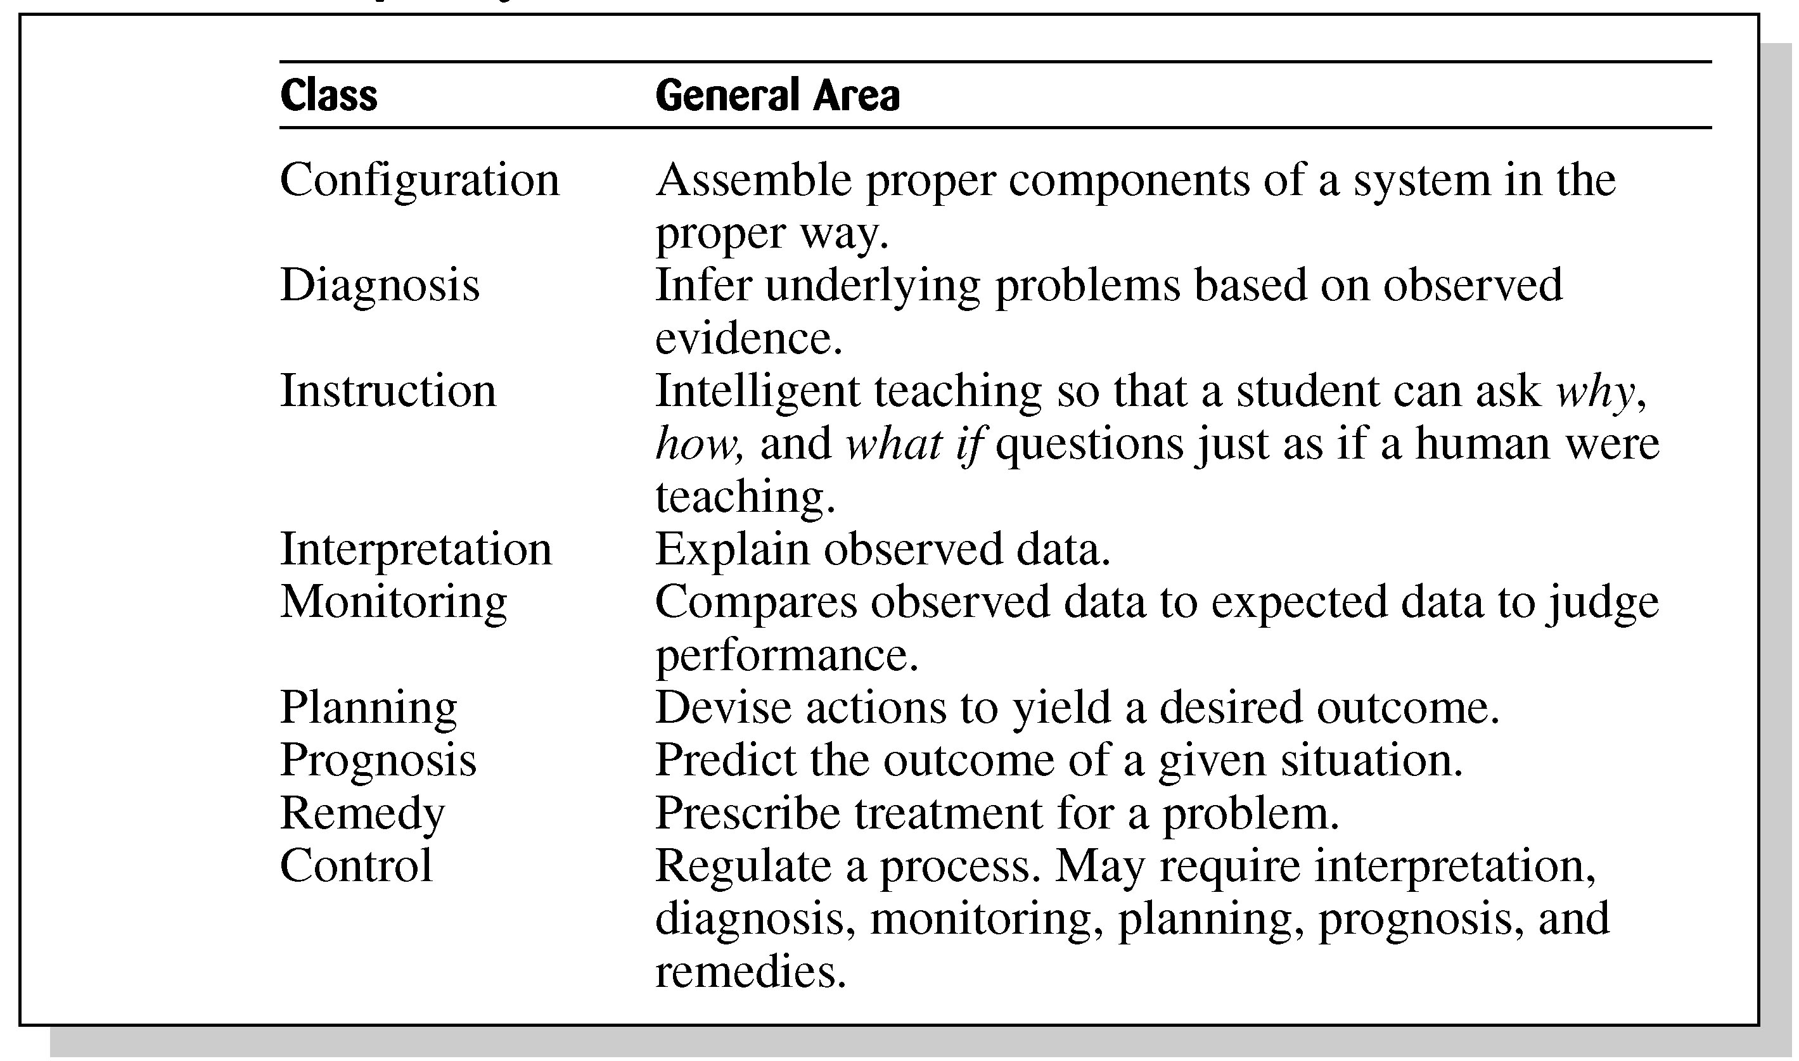
Table 1.3 Broad Classes of Expert Systems

Slide 21
Problems with Algorithmic Solutions
Conventional computer programs generally solve problems having algorithmic solutions.
Algorithmic languages include C, Java, and C#.
Classical AI languages include LISP and PROLOG.

Slide 22
Considerations for Building Expert Systems
Can the problem be solved effectively by conventional programming?
Is there a need and a desire for an expert system?
Is there at least one human expert who is willing to cooperate?
Can the expert explain the knowledge to the knowledge engineer can understand it.
Is the problem-solving knowledge mainly heuristic and uncertain?

Slide 23
Languages, Shells, and Tools
Expert system languages are post-third generation.
Procedural languages (e.g., C) focus on techniques to represent data.
More modern languages (e.g., Java) focus on data abstraction.
Expert system languages (e.g. CLIPS) focus on ways to represent knowledge.

Slide 24
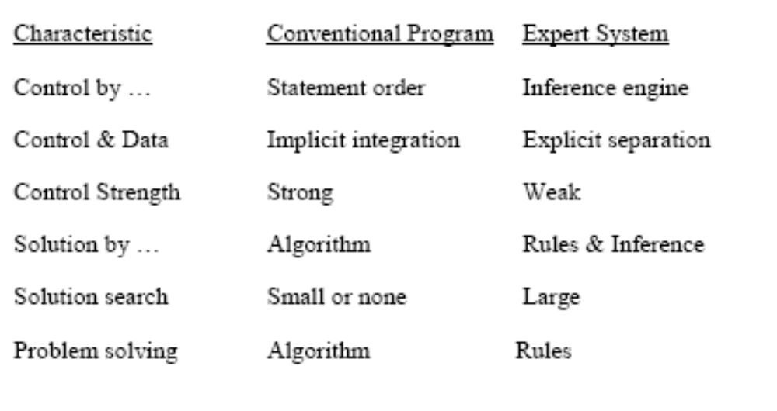
Expert systems Vs conventional programs I

Slide 25
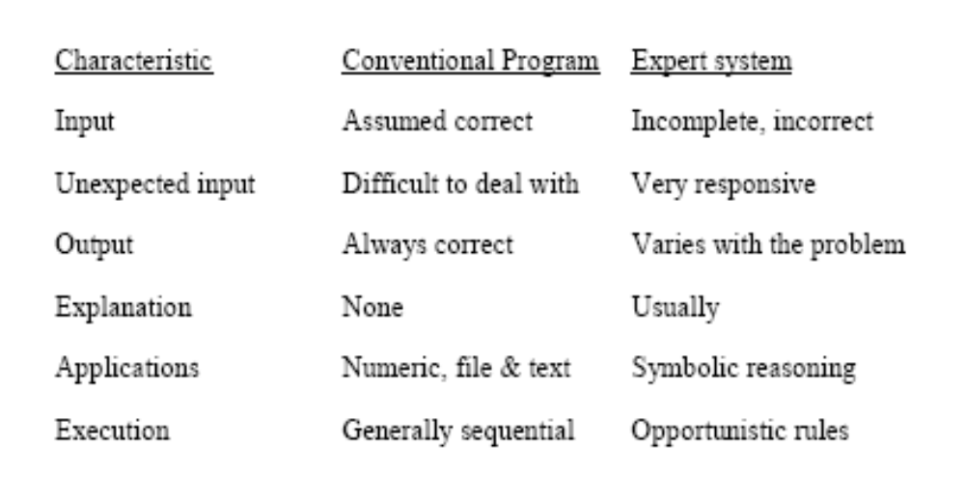
Expert systems Vs conventional programs II

Slide 26
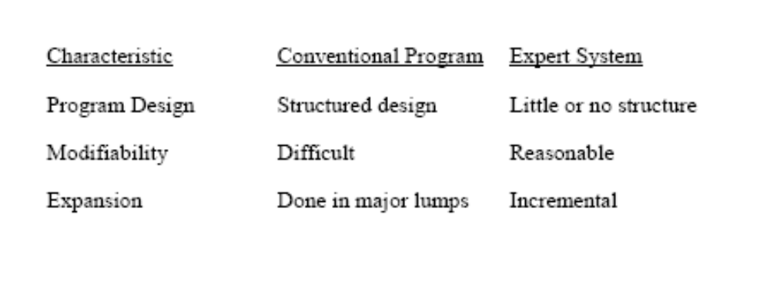
Expert systems Vs conventional programs III

Slide 27
Elements of an Expert System
User interface – mechanism by which user and system communicate.
Exploration facility – explains reasoning of expert system to user.
Working memory – global database of facts used by rules.
Inference engine – makes inferences deciding which rules are satisfied and prioritizing.

Slide 28
Elements Continued
Agenda – a prioritized list of rules created by the inference engine, whose patterns are satisfied by facts or objects in working memory.
Knowledge acquisition facility – automatic way for the user to enter knowledge in the system bypassing the explicit coding by knowledge engineer.
Knowledge Base – includes the rules of the expert system

Slide 29
Production Rules
Knowledge base is also called production memory.
Production rules can be expressed in IF-THEN pseudocode format.
In rule-based systems, the inference engine determines which rule antecedents are satisfied by the facts.

Slide 30
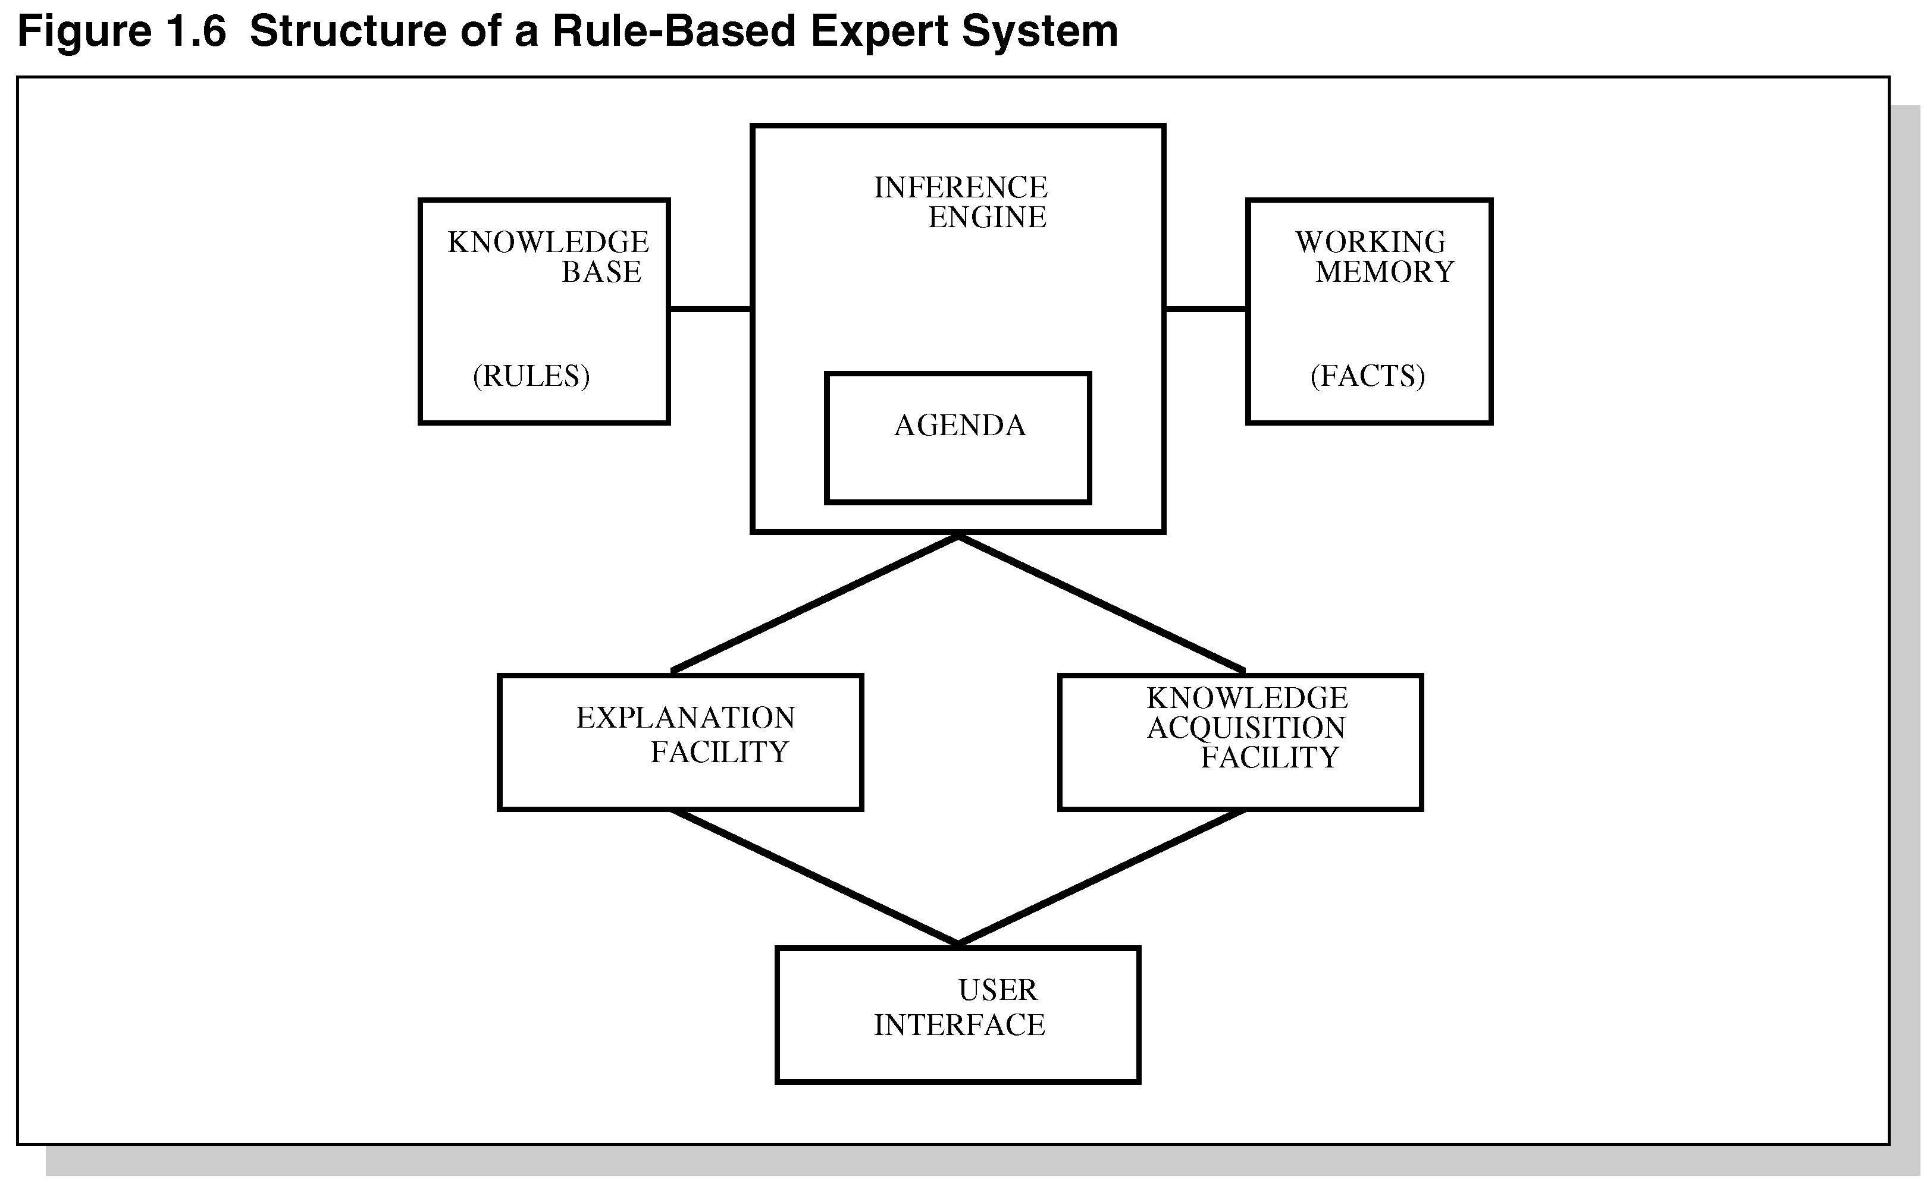
Figure 1.6 Structure of a
Rule-Based Expert System

Slide 31
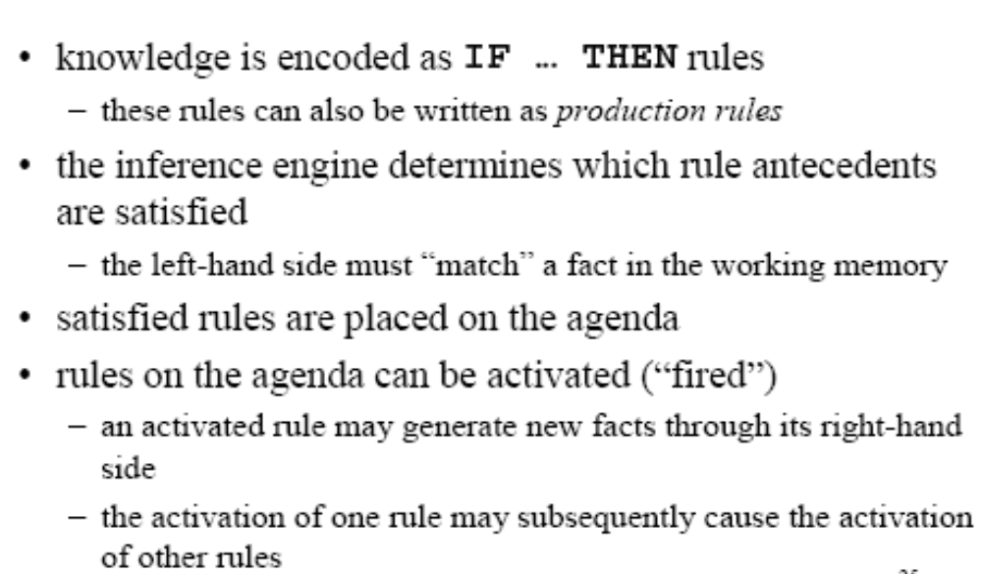
Rule-Based ES

Slide 32
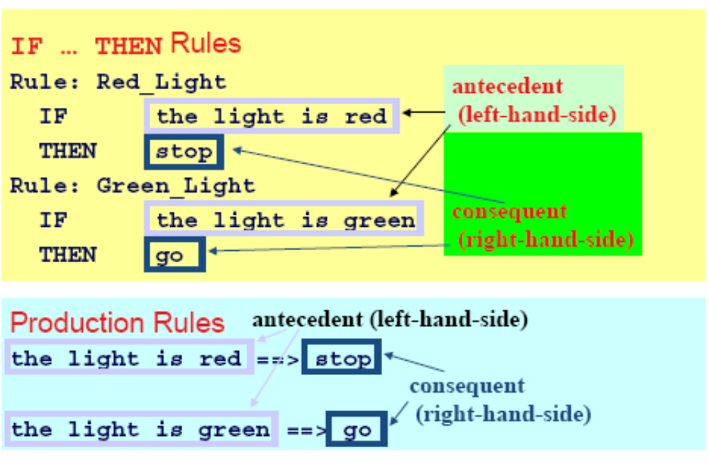
Example Rules

Slide 33
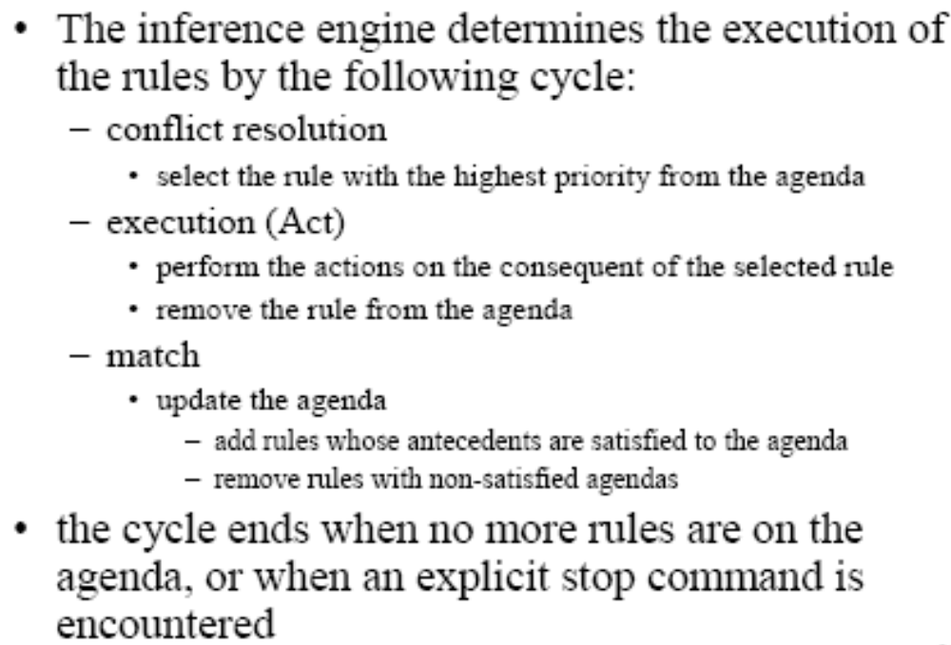
Inference Engine Cycle

Slide 34
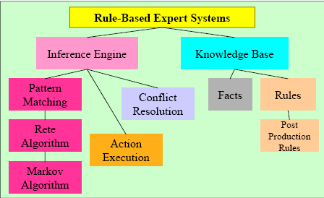
Foundation of Expert Systems

Slide 35
General Methods of Inferencing
Forward chaining (data-driven)– reasoning from facts to the conclusions resulting from those facts – best for prognosis, monitoring, and control.
  Examples: CLIPS, OPS5
Backward chaining (query/Goal driven)– reasoning in reverse from a hypothesis, a potential conclusion to be proved to the facts that support the hypothesis – best for diagnosis problems.
  Examples: MYCIN

Slide 36
Production Systems
Rule-based expert systems – most popular type today.
Knowledge is represented as multiple rules that specify what should/not be concluded from different situations.
Forward chaining – start w/facts and use rules do draw conclusions/take actions.
Backward chaining – start w/hypothesis and look for rules that allow hypothesis to be proven true.

Slide 37
Post Production System
Basic idea – any mathematical / logical system is simply a set of rules specifying how to change one string of symbols into another string of symbols.
    these rules are also known as rewrite rules
    simple syntactic string manipulation
    no understanding or interpretation is required\also used to define grammars of languages
      e.g BNF grammars of programming languages.
Basic limitation – lack of control mechanism to guide the application of the rules.

Slide 38
Markov Algorithm
An ordered group of productions applied in order or priority to an input string.
If the highest priority rule is not applicable, we apply the next, and so on.
inefficient algorithm for systems with many rules.
Termination on (1) last production not applicable to a string, or (2) production ending with period applied
Can be applied to substrings, beginning at left

Slide 39
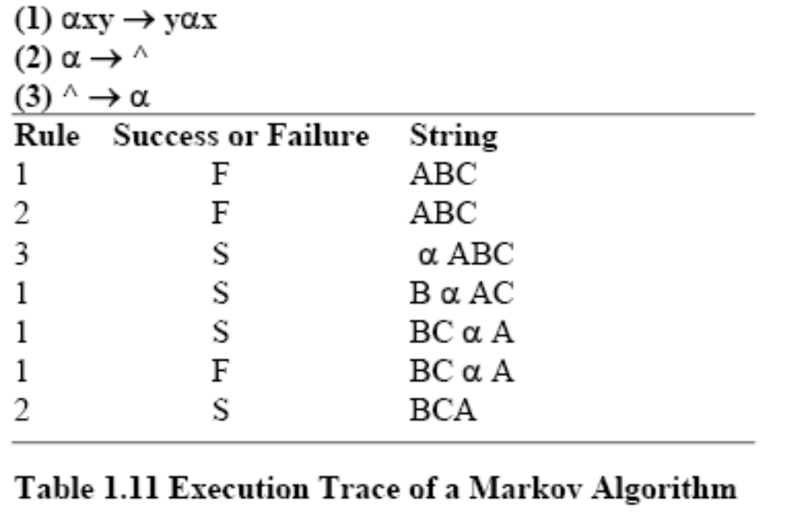
Markov Algorithm

Slide 40
Rete Algorithm
Markov: too inefficient to be used with many rules
Functions like a net – holding a lot of information.
Much faster response times and rule firings can occur compared to a large group of IF-THEN rules which would have to be checked one-by-one in conventional program.
Takes advantage of temporal redundancy and structural similarity.
Looks only for changes in matches (ignores static data)
Drawback is high memory space requirements.

Slide 41
Procedural Paradigms
Algorithm – method of solving a problem in a finite number of steps.
Procedural programs are also called sequential programs.
The programmer specifies exactly how a problem solution must be coded.

Slide 42
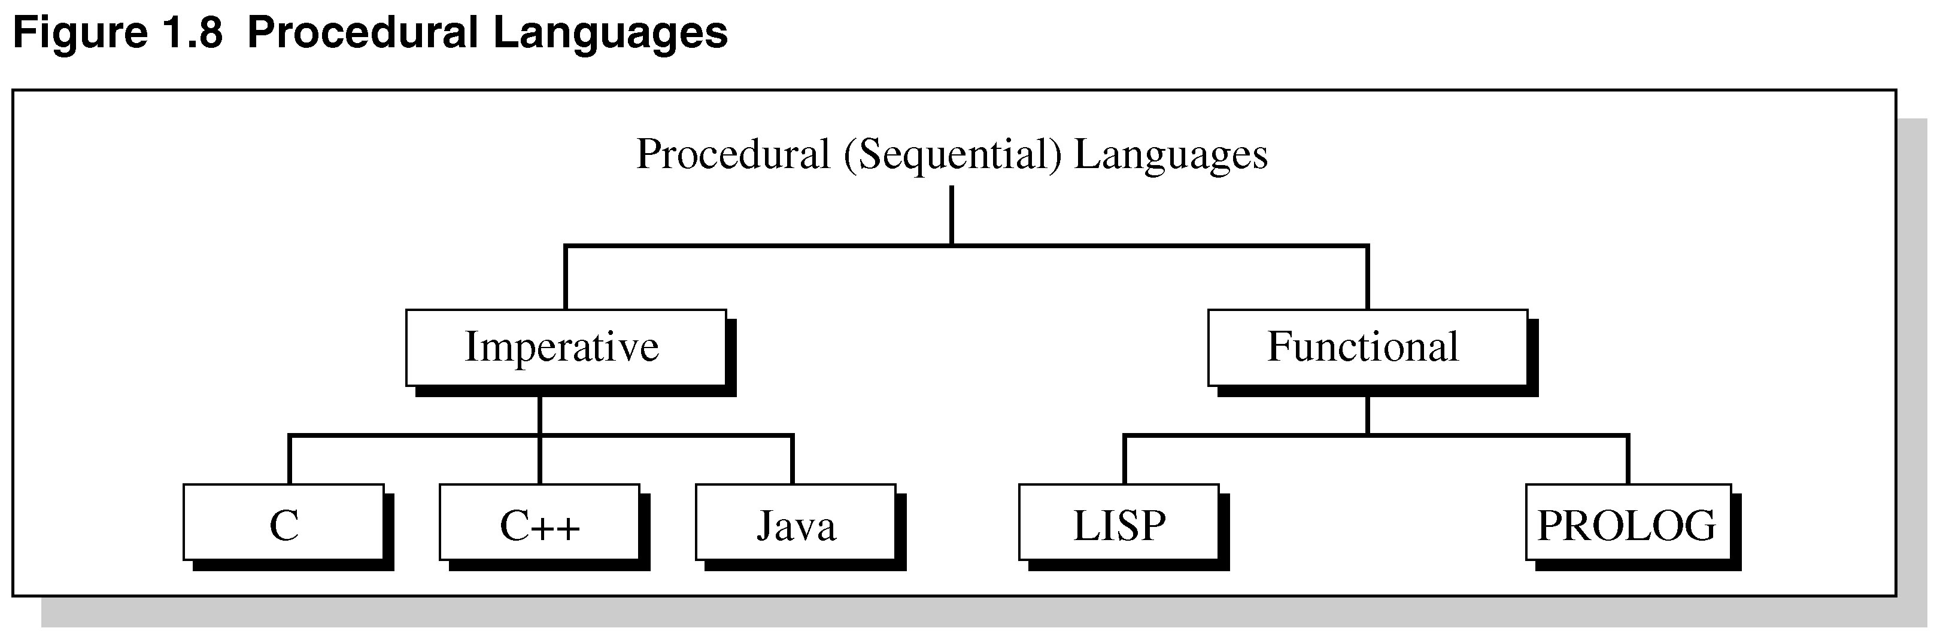
Figure 1.8 Procedural Languages

Slide 43
Imperative Programming
Also known as statement-oriented
During execution, program makes transition from the initial state to the final state by passing through series of intermediate states.
Provide rigid control and top-down-design.
Not efficient for directly implementing expert systems.

Slide 44
Functional Programming
Function-based (association, domain, co-domain); f: S→ T
Not much control
Bottom-up→ combine simple functions to yield more powerful functions.
Mathematically a function is an association or rule that maps members of one set, the domain, into another set, the codomain.
e.g. LISP and Prolog

Slide 45
Nonprocedural Paradigms
Do not depend on the programmer giving exact details how the program is to be solved.
Declarative programming – goal is separated from the method to achieve it.
Object-oriented programming – partly imperative and partly declarative – uses objects and methods that act on those objects.
Inheritance – (OOP) subclasses derived from parent classes.

Slide 46
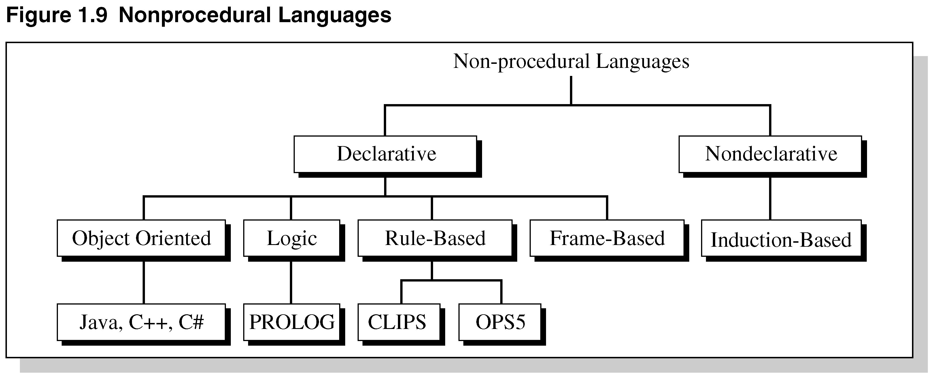
Figure 1.9 Nonprocedural Languages

Slide 47
What are Expert Systems?
Can be considered declarative languages:
Programmer does not specify how to achieve a goal at the algorithm level.
Induction-based programming – the program learns by generalizing from a sample.

Slide 48
Artificial Neural Systems
In the 1980s, a new development in programming paradigms appeared called artificial neural systems (ANS).
Based on the way the brain processes information.
Models solutions by training simulated neurons connected in a network.
ANS are found in face recognition, medical diagnosis, games, and speech recognition.

Slide 49
ANS Characteristics
A complex pattern recognition problem –computing the shortest route through a given list of cities.
ANS is similar to an analog computer using simple processing elements connected in a highly parallel manner.
Processing elements perform Boolean / arithmetic functions in the inputs
Key feature is associating weights w/each element.

Slide 50
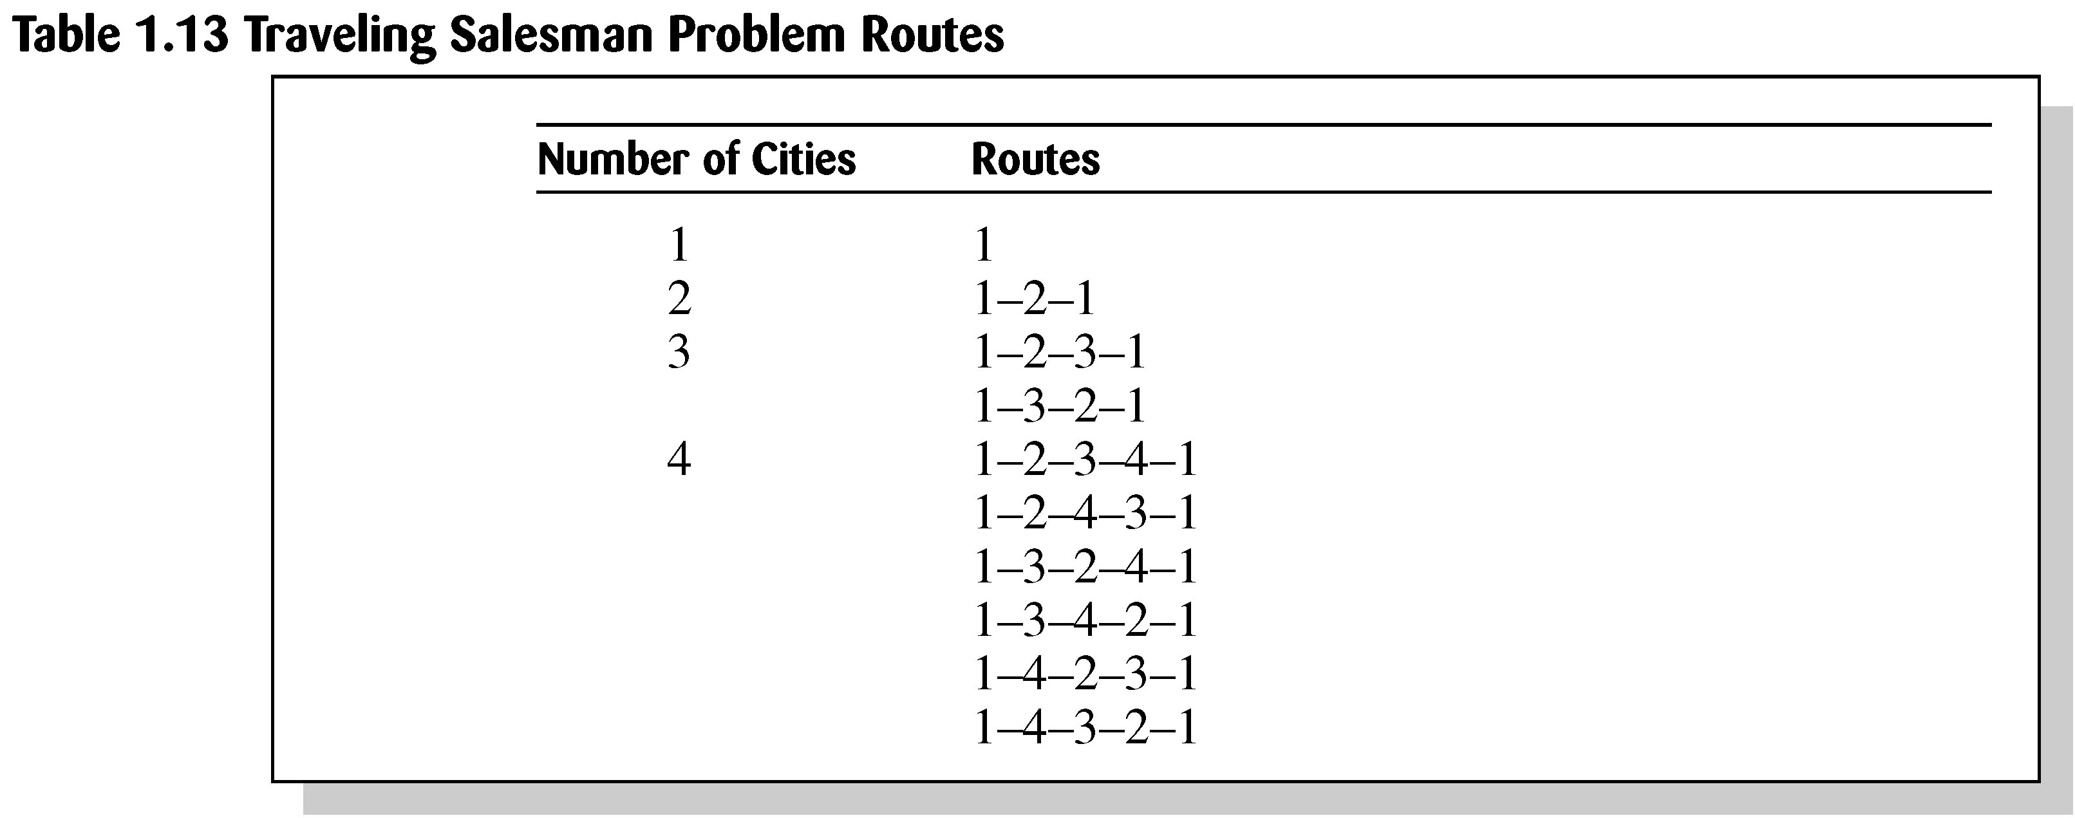
Table 1.13 Traveling
Salesman Problem

Slide 51
Advantages of ANS
Storage is fault tolerant
Quality of stored image degrades gracefully in proportion to the amount of net removed.
Nets can extrapolate (extend) and interpolate (insert/estimate) from their stored information.
Nets have plasticity.
Excellent when functionality is needed long-term w/o repair in hostile environment – low maintenance.

Slide 52
Disadvantage of ANS
ANS are not well suited for number crunching or problems requiring optimum solution.

Slide 53
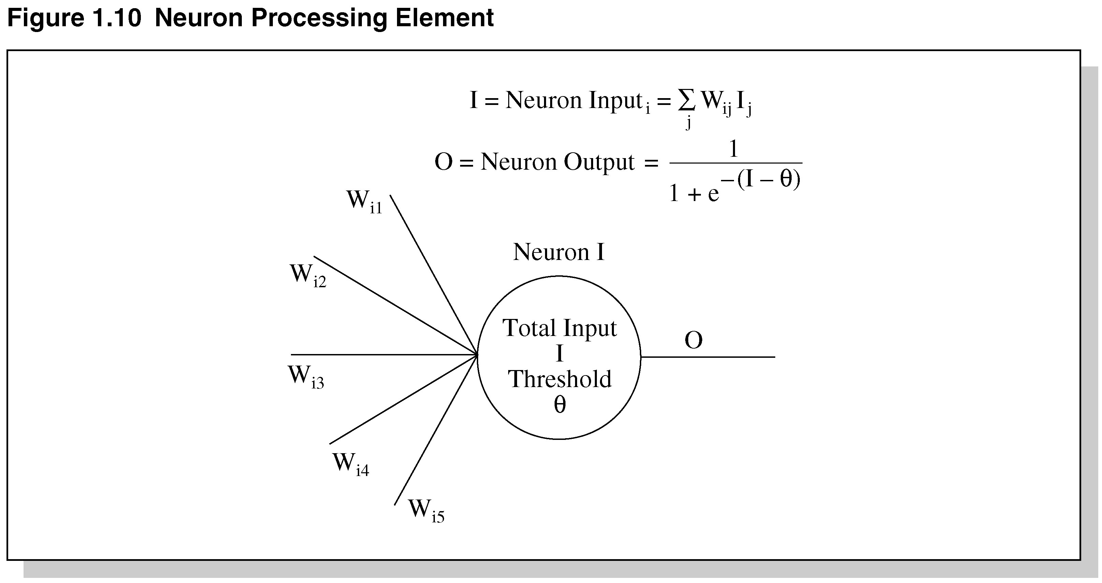
Figure 1.10 Neuron
Processing Element

Slide 54
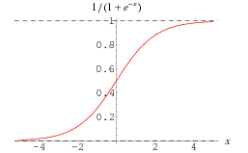
Sigmoid Function

Slide 55
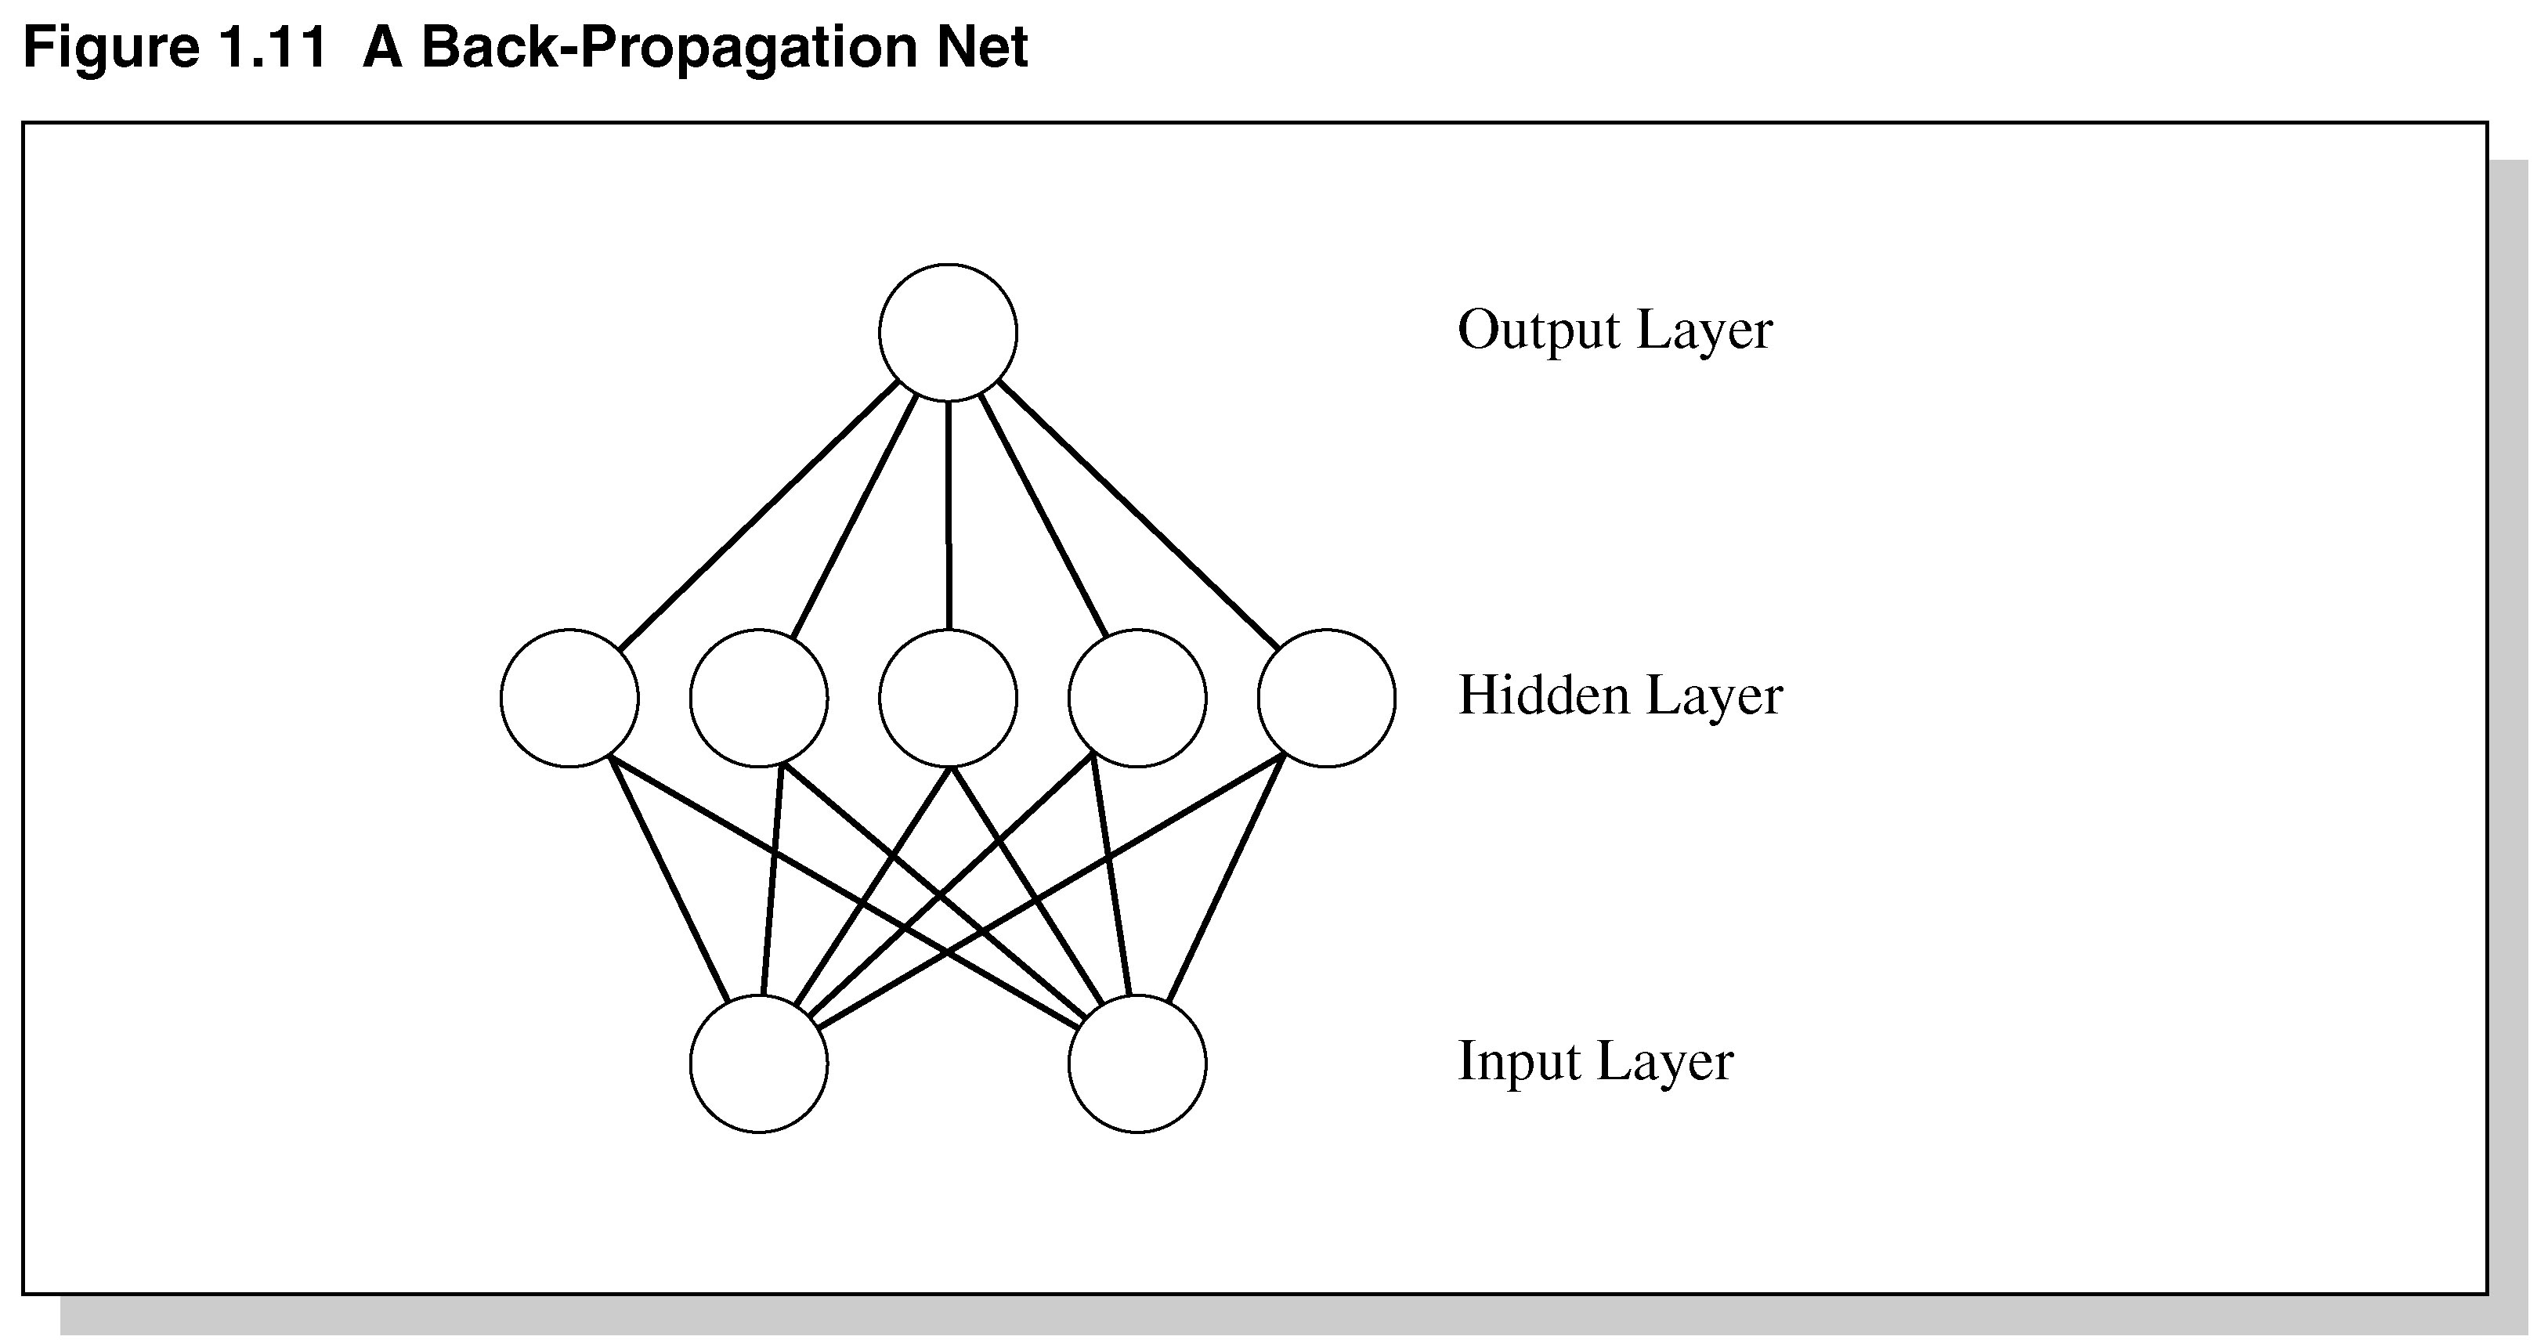
Figure 1.11 A
Back-Propagation Net

Slide 56
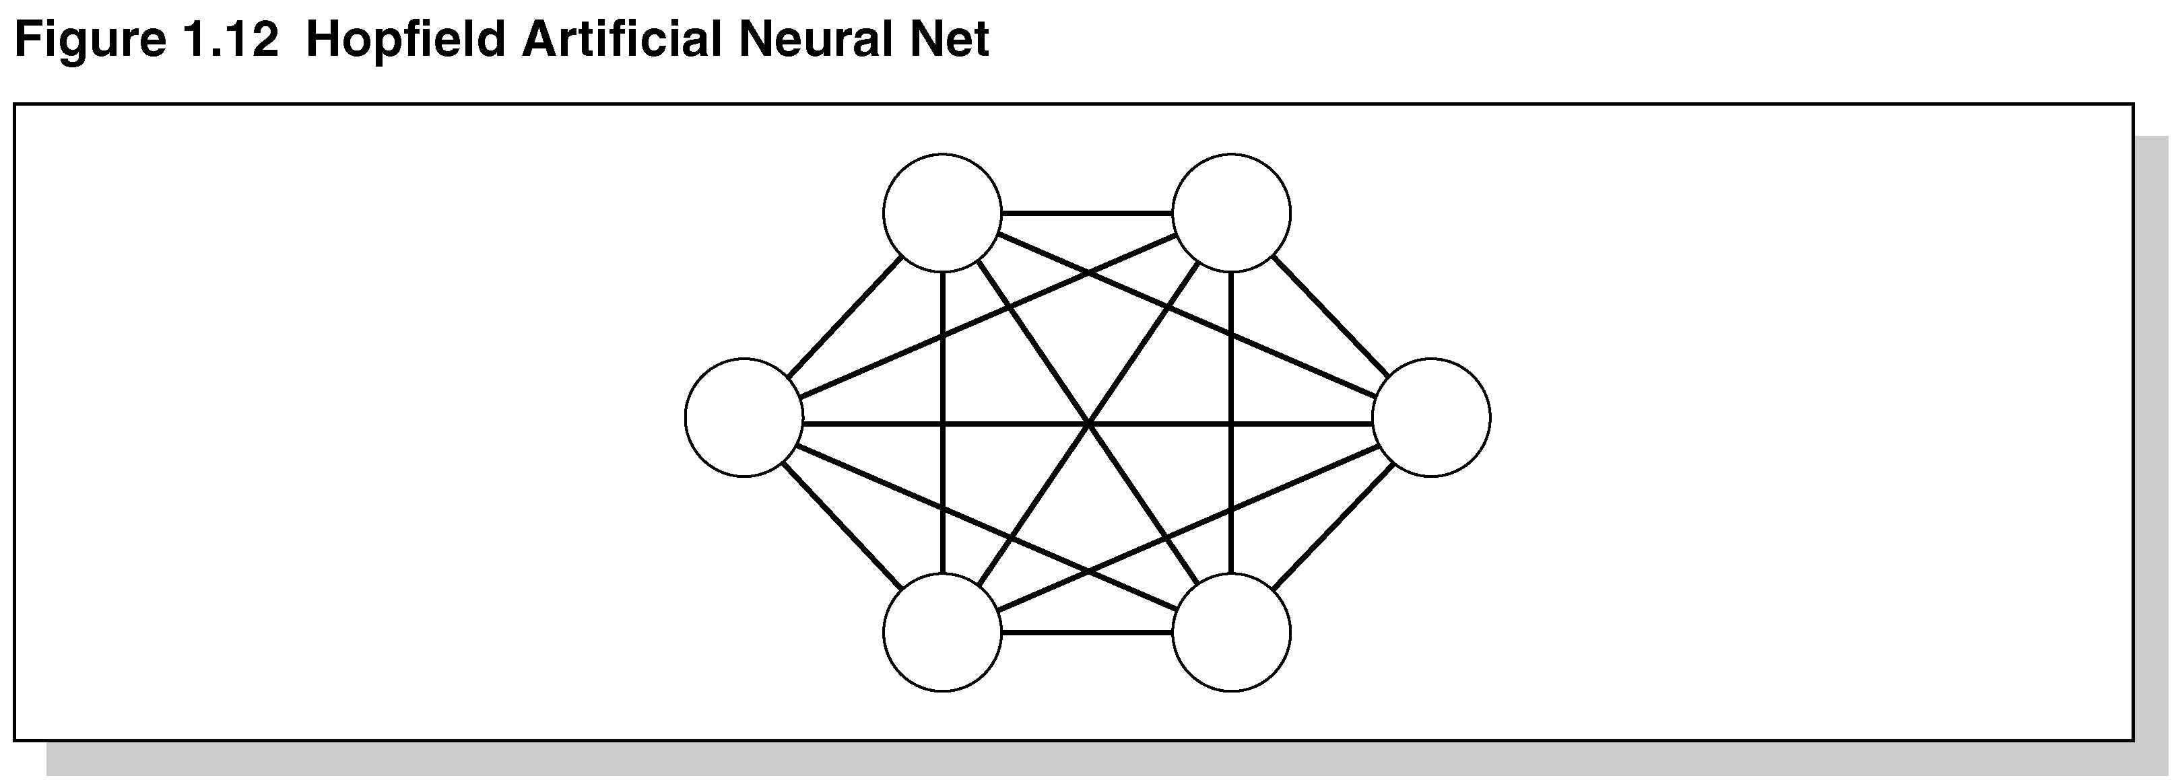
Figure 1.12 Hopfield
Artificial Neural Net

Slide 57
MACIE
An inference engine called MACIE (Matrix Controlled Inference Engine) uses ANS knowledge base.
Designed to classify disease from symptoms into one of the known diseases the system has been trained on.
MACIE uses forward chaining to make inferences and backward chaining to query user for additional data to reach conclusions.

Slide 58
Summary
During the 20th Century various definitions of AI were proposed.
In the 1960s, a special type of AI called expert systems dealt with complex problems in a narrow domain, e.g., medical disease diagnosis.
Today, expert systems are used in a variety of fields.
Expert systems solve problems for which there are no known algorithms.

Slide 59
Summary Continued
Expert systems are knowledge-based – effective for solving real-world problems.
Expert systems are not suited for all applications.
Future advances in expert systems will hinge on the new quantum computers and those with massive computational abilities in conjunction with computers on the Internet.

